Slide 1
Sequence and Activity Diagrams

Slide 2
Importance of Sequence Diagrams
Depict object interactions in a given scenario identified for a given Use Case
Specify the messages passed between objects using horizontal arrows including messages to/from external actors
Time increases from Top to bottom

Slide 3
Rules of Sequence Diagrams
Sequence Initiation

Slide 4
Rules of Sequence Diagrams
Identify objects needed to support use case, determine sequence of internal events following the external initiating event
Diagrams that are not initiated with an external actor represent only a partial sequence
Partial sequence diagrams should clearly identify the actor initiated sequence diagrams from which they are launched

Slide 5
Rules of Sequence Diagrams
Messages specified on interactions can be synchronous or asynchronous
Synchronous call

Slide 6
Rules of Sequence Diagrams
Asynchronous call

Slide 7
Rules of Sequence Diagrams
Display operation names on call arrows

Slide 8
Rules of Sequence Diagrams
Compound and Simple Iteration

Slide 9
‘included’ sequence diagrams

Slide 10
Showing alternate behavior in a sequence diagram

Slide 11
Showing Extension Point

Slide 12
Specifying Timing Requirements

Slide 13
Requirements Elicitation Process Step 4. Refining Use Cases using System Sequence Diagrams
System sequence diagrams establish the dynamic behavior in terms of key scenarios of the system for each use case
The system sequence diagram models a scenario of the system interactions with the environment for a given use case
Input/output events are clearly identified in each sequence diagram,
The State of the system before and after each event are also depicted
Different diagrams model scenarios with the normal flow of events and the abnormal flow of events

Slide 14
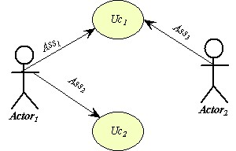
Sequence Diagrams and Use Cases System Sequence Diagram
The use case diagram
Of system S
The sequence diagram of use case UC1 for system S

Slide 15
Example: Use Case Diagram of the Vending Machine

Slide 16
Requirements Elicitation Process Step 6. Identify Initial Analysis Objects- The Initial Object-Model
<<actor>>
<<actor>>
<<actor>>
<<actor>>
<<actor>>
<<actor>>
Designate the Actor objects with the <<actor>> stereotype
above the object label

Slide 17
System Sequence Diagram for Deposit Money Use Case

Slide 18
System Sequence Diagram for Make Selection Use Case

Slide 19
System Sequence Diagram for Cancellation Use Case

Slide 20
System Sequence Diagram for Update Database Use Case

Slide 21
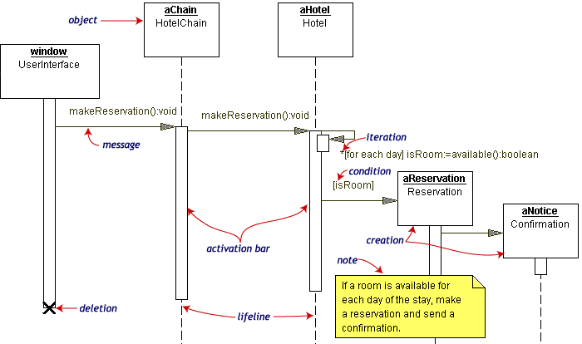
Other Examples of Sequence Diagrams

Slide 22
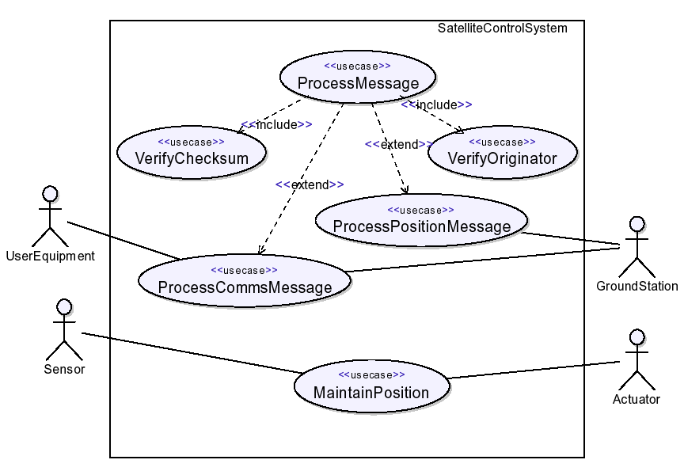
A Simple Example of Using UML2
EXAMPLE: SATELLITE CONTROL SYSTEM

Slide 23
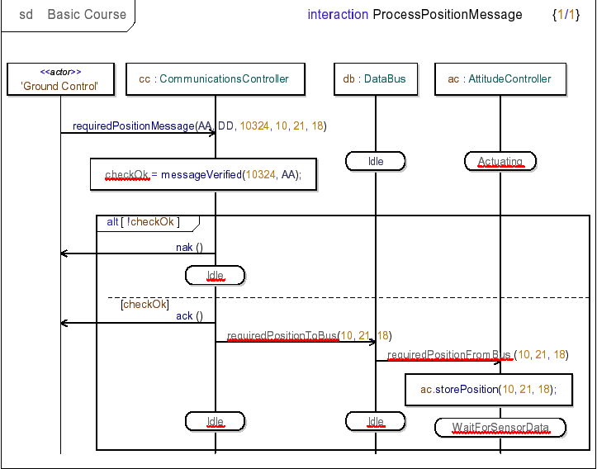
A Simple Example Using UML2
SATELLITE CONTROL SYSTEM Architectural behavior

Slide 24
Activity diagrams
Useful to specify software or hardware system behaviour
Based on data flow models – a graphical representation (with a Directed Graph) of how data move around an information system
[order reject]
Receive
Fill
Ship
Close
Order
Order
Order
Order
[order
accepted]
Send
Invoice
Make Payment
Accept
Invoice
Payment

Slide 25
Some definitions
Flow: permits the interaction between two nodes of the activity diagram (represented by edges in activity diagram)
State: a condition or situation in the life of an object during which it satisfies some conditions, performs some activities, or waits for some events
Type: specifies a domain of objects together with the operations applicable to the objects (also none); includes primitive built-in types (such as integer and string) and enumeration types
Token: contains an object, datum, or locus of control, and is present in the activity diagram at a particular node; each token is distinct from any other, even if it contains the same value as another
Value: an element of a type domain

Slide 26


Actions
The fundamental unit of executable functionality in an activity
The execution of an action represents some transformations or processes in the modeled system (creating objects, setting attribute values, linking objects together, invoking user-defined behaviours, etc.)
Description of the action behaviour

Slide 27





Pins
Actions can have inputs and outputs, through the pins
Hold inputs to actions until the action starts, and hold the outputs of actions before the values move downstream
The name of a pin is not restricted: generally recalls the type of objects or data that flow through the pin
Output pins
Input pins
Standalone pin notations:
the output pin and the input pin have the same name and same type

Slide 28







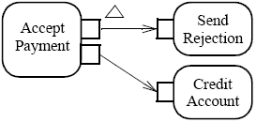

Special kind of pins (1)
Streaming Parameters (notated with {STREAM}): accept or provide one or more values while an action is executing
Exception Output Parameters (notated with a triangle)
Provide values to the exclusion of any other output parameter or outgoing control of the action
The action must immediately terminate, and the output cannot quit
Stand-alone
style

Slide 29
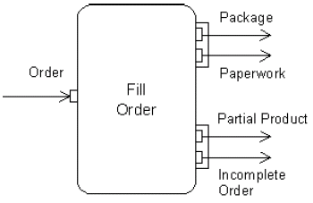


Special kind of pins (2)
Parameter Sets
group of parameters
the action can only accept inputs
from the pins in one of the sets
the action can only provide outputs
to the pins in one of the sets
ValuePin: special kind of input pin defined to provide constant values (the type of specificated value must be compatible with the type of the value pin)
Output is provided only to the first or to the second set
Ray
value
Compute circumference
3.14
π

Slide 30
Conditions to start and end actions
An action can start only if:
all non-stream inputs have arrived (or at least one stream input if there are only stream inputs)
The action can finish only if:
all inputs have arrived (streaming inputs included)
all non-stream and non-exception outputs (or an exception outputs) have been provided
Prevent deadlock: an input pin of an action cannot accept tokens until all the input pins of the action can accept them

Slide 31
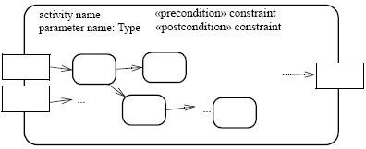


Activities
An activity is the specification of parameterized behaviour as the coordinated sequencing of subordinate units whose individual elements are actions
Uses parameters to receive and provide data to the invoker
Activity nodes
Parameter name
Activity edges
Output parameter
Input parameter
Parameter name
Parameter name
An action can invoke an activity to describe its action more finely
This action invokes the activity Fill Order

Slide 32



Activity nodes
Three type of activity nodes:
Action nodes: executable activity nodes; the execution of an action represents some transformations or processes in the modeled system (already seen)
Control nodes: coordinate flows in an activity diagram between other nodes
Object nodes: indicate an instance of a particular object, may be available at a particular point in the activity (i.e Pins are object nodes)

Slide 33





Activity edges (1)
Are directed connections
They have a source and a target, along which tokens may flow
Any number of tokens can pass along the edge, in groups at one time, or individually at different times
Weight: determines the minimum number of tokens that must traverse the edge at the same time
In this example we use a non-constant weight: an invoice for a particular job can only be sent when all of its tasks have been completed

Slide 34




Activity edges (2)
Two kinds of edges:
Control flow edge - is an edge which starts an activity node after the completion of the previous one by passing a control token
Object flow edge - models the flow of values to or from object nodes by passing object or data tokens
Notation without activity nodes
Notation without activity nodes

Slide 35
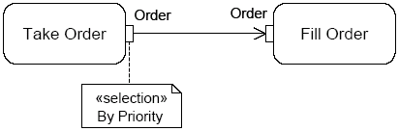
Example – go to Genova
Go to Heaven/Hell ;)
«local precondition»
Have a license
Car crash
Turn on the car
[else]
Fill up with fuel
To motorway tollgate
Catch the ticket
[on car]
[the tank is full]
Get
luggage
ready
Go home with the car
Pay the ticket
Exit to Genova tollgate
[on train]
Go to the station with a friend
Buy the ticket
Obliterate the ticket
Catch the train
Go to Heaven/
Hell ;)
The train
derail
The friend goes home
When the train
arrives
to Genova
Go home with bus
Get off the train
[else]
Study for 5 minutes
[Genova is a long way]

Slide 36

Control nodes – initial nodes
In an activity the flow starts in initial nodes, that return the control immediately along their outgoing edges
If there are more than one initial node, a control token is placed in each initial node when the activity is started, initiating multiple flows
If an initial node has more than one outgoing edge, only one of these edges will receive control, because initial nodes cannot duplicate tokens
A or B ?

Slide 37

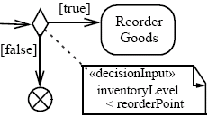
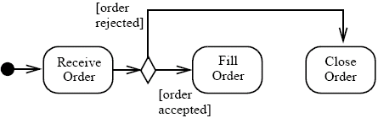

Control nodes – decision nodes
Route the flow to one of the outgoing edges (tokens are not duplicated)
Guards are specified on the outgoing edges or with the stereotype «decisionInput»
There is also the predefined guard [else], chosen only if the token is not accepted by all the other edges
If all the guards fail, the token remains at the source object node until one of the guards accept it

Slide 38

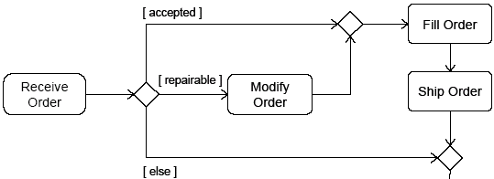

Control nodes – merge nodes
Bring together multiple alternate flows
All controls and data arriving at a merge node are immediately passed to the outgoing edge
There is no synchronization of flows or joining of tokens

Slide 39

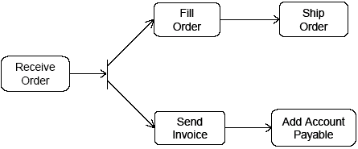
Control nodes – fork nodes
Fork nodes split flows into multiple concurrent flows (tokens are duplicated)
State machine forks in UML 1.5 required synchronization between parallel flows through the state machine RTC step (it means that the first state in each branch is executed, then the second one, etc.)
UML 2.0 activity forks model unrestricted parallelism

Slide 40

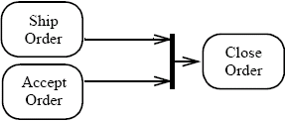

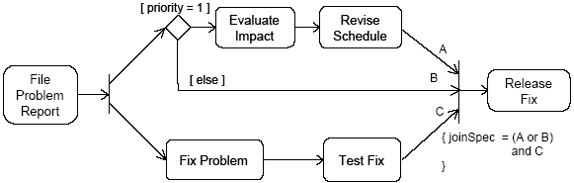
Control nodes – join nodes
Join nodes synchronize multiple flows
Generally, controls or data must be available on every incoming edge in order to be passed to the outgoing edge, but user can specify different conditions under which a join accepts incoming controls and data using a join specification

Slide 41
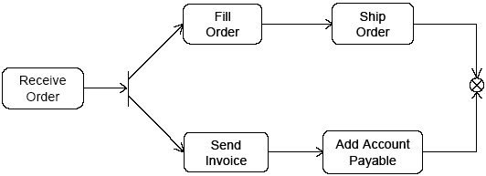


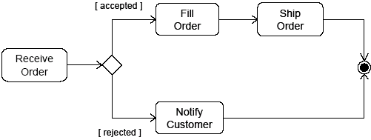
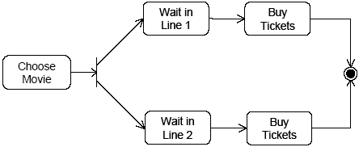
Control nodes – final nodes
Flow final:
destroys the tokens that arrive into it
the activity is terminated when all tokens in the graph are destroyed
Final node:
the activity is terminated when the first token arrives
intentional race between flows

Slide 42

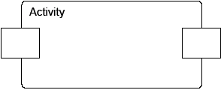
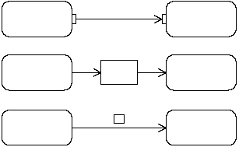



Object nodes
Hold data temporarily while they wait to move through the graph
Specify the type of values they can hold (if no type is specified, they can hold values of any type)
Can also specify the state of the held objects
There are four kinds of object nodes:
Central Buffer Nodes
Data Store Nodes
Activity Parameter Nodes
Pins
(three differents notations)

Slide 43

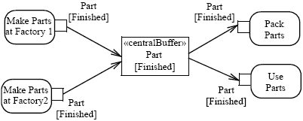
Object nodes – centralBuffer
A central buffer node is an object node that manages flows from multiple sources and destinations (as opposed to pins and parameters)
Acts as a buffer for multiple input flows and output flows
Is not tied to an action like pins, or to an activity like activity parameter nodes
The centralBuffer node collects the object Parts, and each Part can be used or packet (but not both)

Slide 44

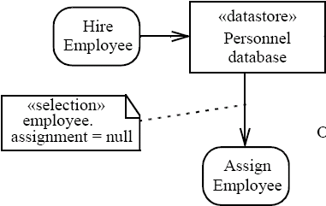
Object nodes – datastore
Is a specific central buffer node which stores objects persistently
Keeps all tokens that enter into it
Tokens chosen to move downstream are copied so that tokens never leave the data store
If arrives a token containing an object already present in the data store, this replaces the old one
Tokens in a data store node cannot be removed (they are removed when the activity is terminated)
Notes:
Hire = assumere

Slide 45

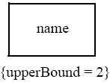
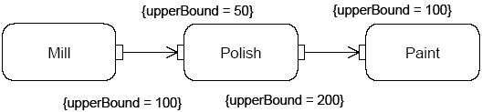
Object nodes - multiplicities and upperBound
Multiplicities: specify the minimum (≥0) and maximum number of values each pin accepts or provides at each invocation of the action:
when is available the minimum number of values, the action can start
if there is more values than the maximum, the action takes only the first maximum value
UpperBound: shows the maximum number of values that an object node can hold: at runtime, when the upper bound has been reached, the flow is stopped (buffering)

Slide 46
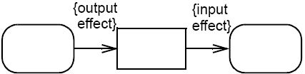


Object nodes – effect and ordering
Effect: pins can be notated with the effect that their actions have on objects that move through the pin
The effects can be: ‘create’ (only on output pins), ‘read’, ‘update’ or ‘delete’ (only on input pins)
Ordering: specifies the order in which the tokens of an object node are offered to the outgoing edges (FIFO, LIFO or modeler-defined ordering)

Slide 47




Activity edges – presentation options
An edge can also be notated using a connector
Every connector with a given label must be paired with exactly one other with the same label on the same activity diagram
is equivalent to
To reduce clutter in complex diagrams, object nodes may be elided
is equivalent to

Slide 48

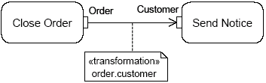

Activity edges - transformation
It is possible to apply a transformation of tokens as they move across an object flow edge (each order is passed to the transformation behaviour and replaced with the result)
<<transformation>>
transformation specification
In this example, the transformation gets the value of the attribute Customer of the Order object

Slide 49
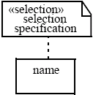
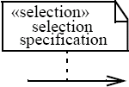
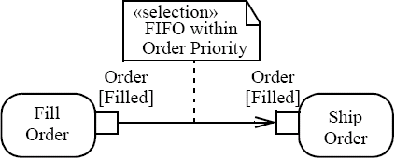
Selection
Specifies the order (FIFO, LIFO or modeler-defined ordering) in which tokens in the node are offered to the outgoing edges
Can be applied to:
Object node - specifies the object node ordering, choosing what token offers to the outgoing edge whenever it asks a token
Edge - chooses the order on which tokens are offered from the source object node to the edge (overrides any selection present on the object node, that is object node ordering)

Slide 50
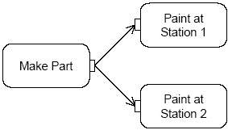
Token competition
A parameter node or pin may have multiple edges coming out of it, whereupon there will be competition for its tokens, because object nodes cannot duplicate tokens while forks can
Then there is indeterminacy in the movement of data in the graph
If the input pin of Paint at Station 1 is full, the token remains at the output of Make Part until the traversal can be completed to one of the input pins

Slide 51
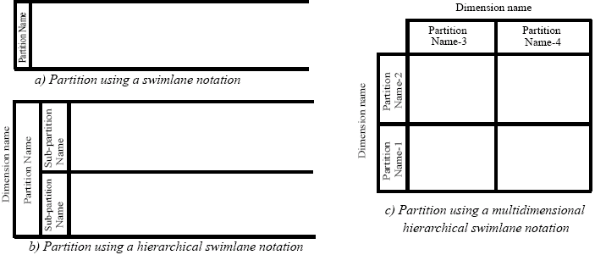
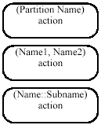

ActivityPartition (1)
Partitions divide the nodes and edges for identifying actions that have some characteristics in common
They often correspond to organizational units in a business model
Partitions can be hierarchical and multidimensional
Additional notation is provided: placing the partition name in parenthesis above the activity name

Slide 52
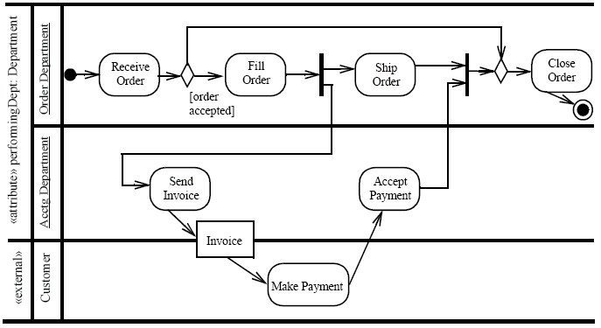
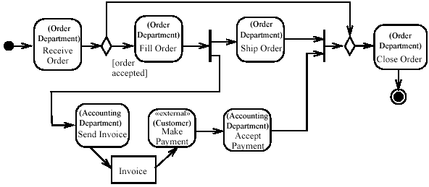
ActivityPartition (2)
Partition notated to occur outside the primary concern of the model

Slide 53
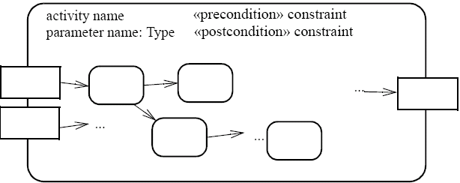
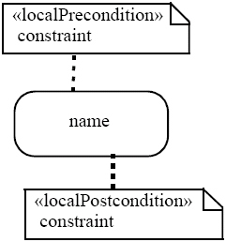
Pre & post condition (1)
Can be referred to an activity or to an action (local condition)
UML intentionally does not specify when or whether pre/post conditions are tested (design time, runtime, etc.)
UML also does not define what the runtime effect of a failed pre/post condition should be (error that stops execution, warning, no action)

Slide 54
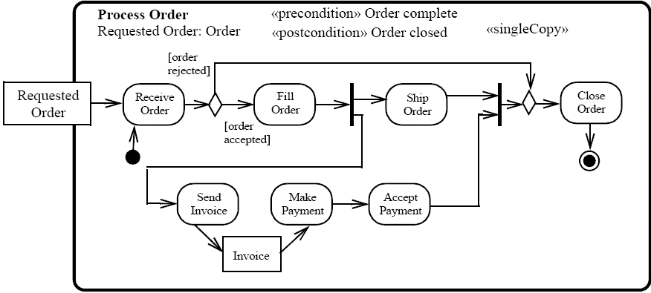
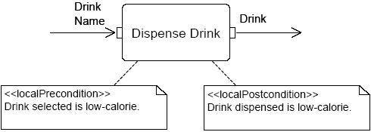
Pre & post condition (2)

Slide 55

SendSignalAction
Creates a signal instance from its inputs, and transmits it to the target object (local or remote)
A signal is an asynchronous stimulus that triggers a reaction in the receiver in an asynchronous way and without a reply
Any reply message is ignored

Slide 56
Time triggers and Time events
A Time trigger is a trigger that specifies when a time event will be generated
Time events occur at the instant when a specified point in time has transpired
This time may be relative or absolute
Relative time trigger: is specified with the keyword ‘after’ followed by an expression that evaluates to a time value
Absolute time trigger: is specified as an expression that evaluates to a time value
after (5 seconds)
Jan, 1, 2000, Noon
Relative time trigger
Absolute time trigger

Slide 57


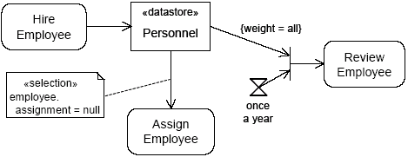
AcceptEventAction
Waits for the occurrence of an event meeting specified conditions
Two kinds of AcceptEventAction:
Accept event action – accepts signal
events generated by a SendSignalAction
Wait time action – accepts time events
Accept event action
Wait time action
The objects stored in Personnel are only retrieved when the join succeeds (only once a year)

Slide 58
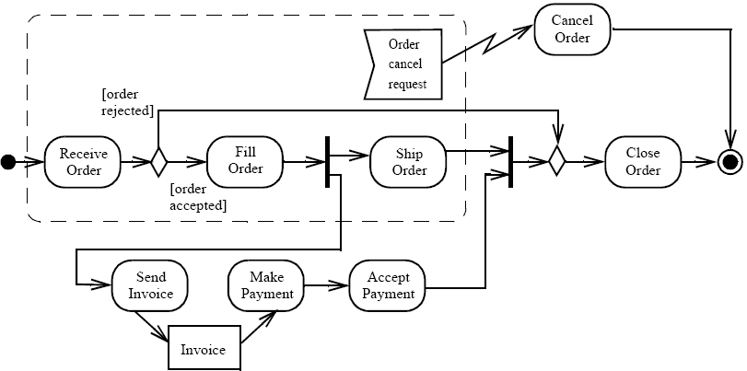

InterruptibleActivityRegion
Is an activity group (sets of nodes and edges) that supports termination of tokens flowing into it
When a token leaves an interruptible region via interrupting edges, all tokens and behaviours in the region are terminated
Token transfer is still atomic: a token transition is never partial; it is either complete or it does not happen at all (also for internal stream)
Interrupting edge

Slide 59
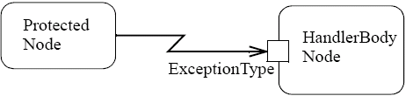
Exceptions (1)
Exception handler - specifies the code to be executed when the specified exception occurs during the execution of the protected node
When an exception occurs the set of execution handlers on the action is examined to look for a handler that matches (catches) the exception
If the exception is not caught, it is propagated to the enclosing protected node, if one exists
If the exception propagates to the topmost level of the system and is not caught, the behaviour of the system is unspecified; profiles may specify what happens in such cases

Slide 60
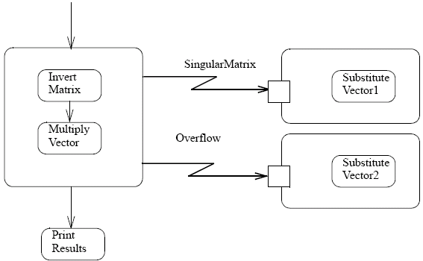
Exceptions (2)
When an exception is caught, is executed the exception body instead of the protected node, and then the token is passed to all the edges that go out from that protected node
The exception body has no explicit input or output edges
Exception body can resolve the problems that have caused the exception or can abort the program
We can put any activities nested in a protected node (in UML 2.0, nesting activities is allowed)
Protected node with two nested activities
HandlerBody node
Successful end

Slide 61
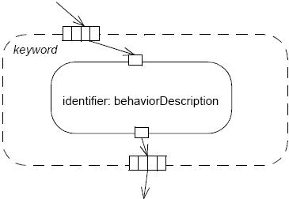
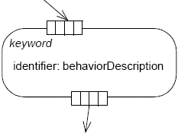
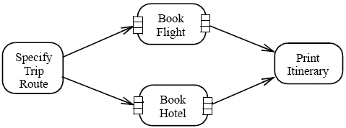
ExpansionRegion (1)
Nested region of an activity in which each input is a collection of values
The expansion region is executed once for each element (or position) in the input collection
On each execution of the region, an output value from the region is inserted into an output collection at the same position as the input elements

Slide 62
ExpansionRegion (2)
There are three ways of interaction between the executions:
Parallel (concurrent): all the interactions are independent
Iterative: the interactions occur in the order of the elements (the executions of the region must happen in sequence, with one finishing before another can begin)
Stream (streaming): there is a single execution of the region, where the values in the input collection are extracted and placed into the execution of the expansion region as a stream (in order if the collection is ordered)

